Slide 1
Signaling and Safety Devices
Road Signs
(Civil Engineering )

Slide 2
Signaling and Safety Devices
Signaling and Safety Devices are placed so that transport can be provided to more trains on one railway without any bad consequences. These devices show the train driver if entrance on the station is allowed or it is not.
There are :
Side by side signaling and safety devices
Railway signaling and safety devices
Automatic devices for providing road crossings with the assistance of remote control with the same level
Devices with remote control
Аdevices for automatic descent

Slide 3
Signals
Signals present technical devices that allow or forbid transport of trains and regulate the speed of the trains.
According to the position there are:
Fore signals
Protective signals
Main signals

Slide 4
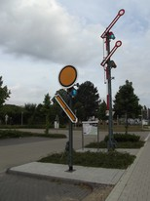

Slide 5
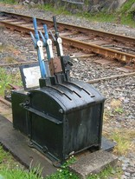

Slide 6
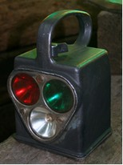

Slide 7
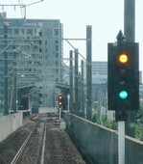

Slide 8
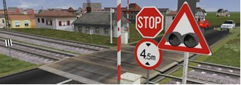

Slide 9
Fore Signals inform the train driver for the main signal, if the railway is open or close and they are placed 400 m before the main signals.
Protective signals are placed in that location where there is a crossing on the road with the railway. They can be manually regulated , semi automatic or automatic . They are placed 240 m before the crossing.
On an open crossing Andreev cross is placed.
Main signals serve for information if the entrance of the station is free or it is not. They are divided into: entrance , exit and maneuver.
Automatic devices are regulated with remote control.
They can be :road –lightening-acoustic, road –lightening-acoustic semi bumpers and road –lightening-acoustic with double bumping.

Slide 11
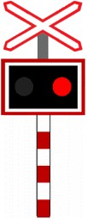

Slide 12
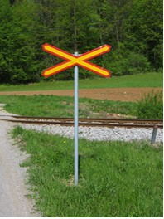

Slide 13
Remote controlling
Remote controlling is placed in the head quarter with a center for controlling. In the center there is a control chair, control screen with the situation of the line and electronic system for data processing.
The railway has its own telephone system and network where you can use voice signals, written telephones or code types.

Slide 14
